Slide 1
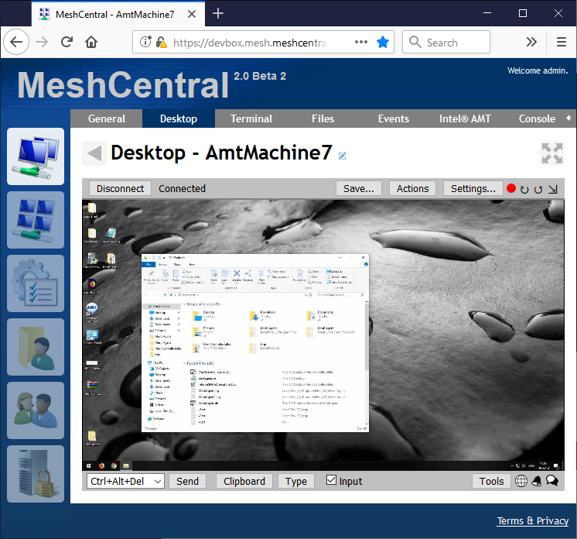
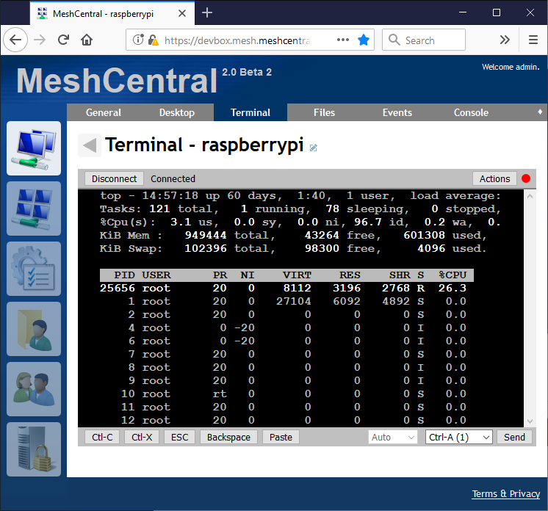
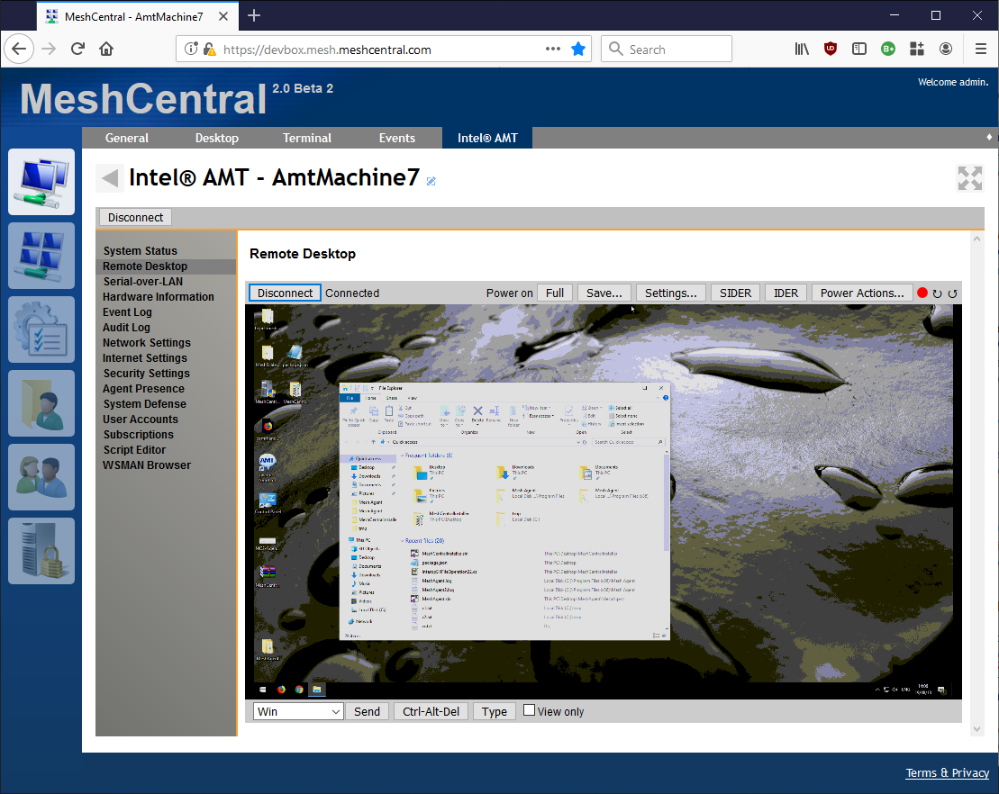

Slide 2
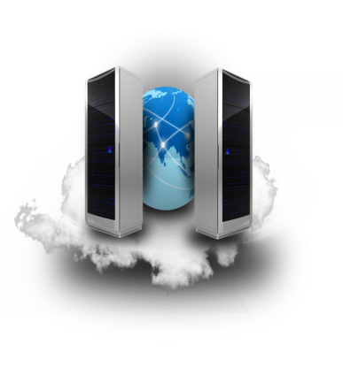
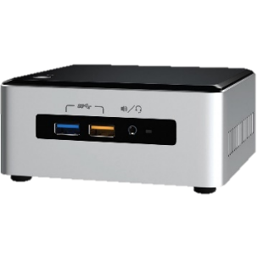

MeshCentral
{
"domains": {
"": {
"title": "My Server",
"SessionRecording": {
"filepath": "C:\\recordings",
"protocols": [ 1, 2, 100, 101 ]
}
}
}
}
…
Time
Data
Time
Data
Time
Data
file.mcrec
Config.json

Slide 3
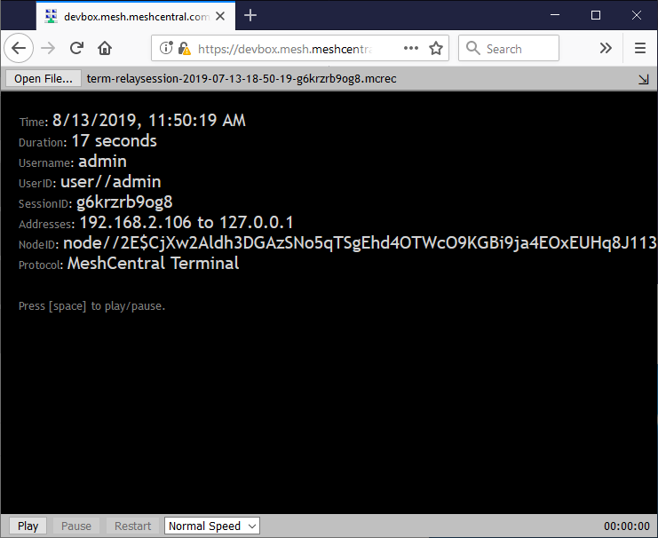
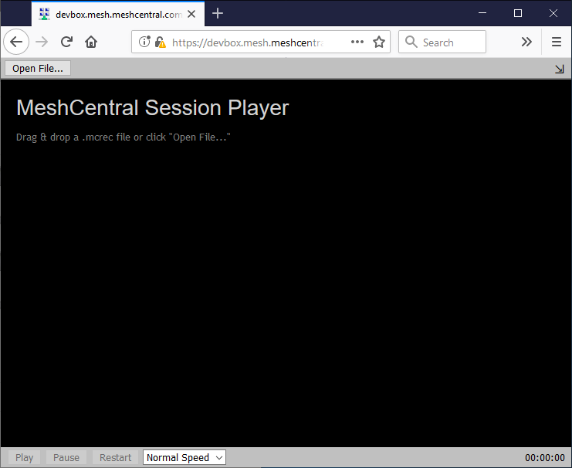
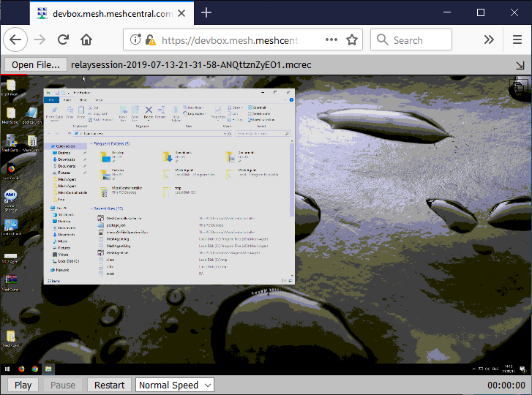
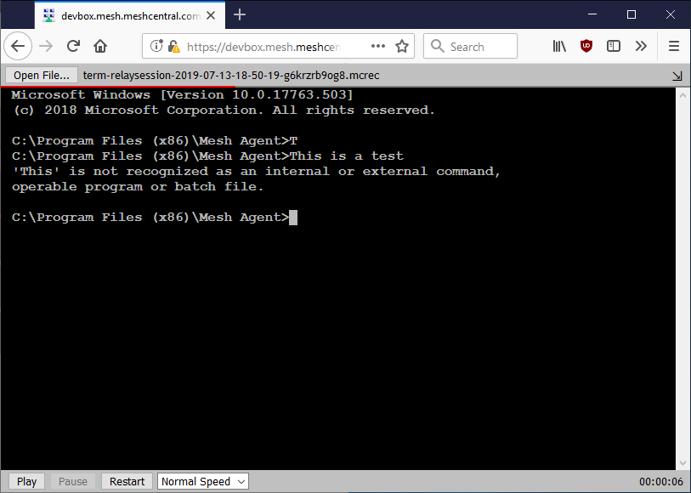
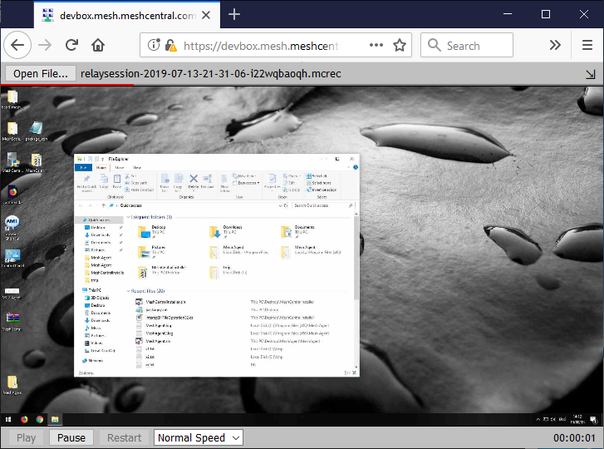
.mcrec

Slide 4
First full frame
Time
Partial frames

Slide 5
1
2
3
4
5
6
7
8
9
Frame numbers
1
1
1
1
1
Index
3
4
5
5
5
7
9

Slide 6
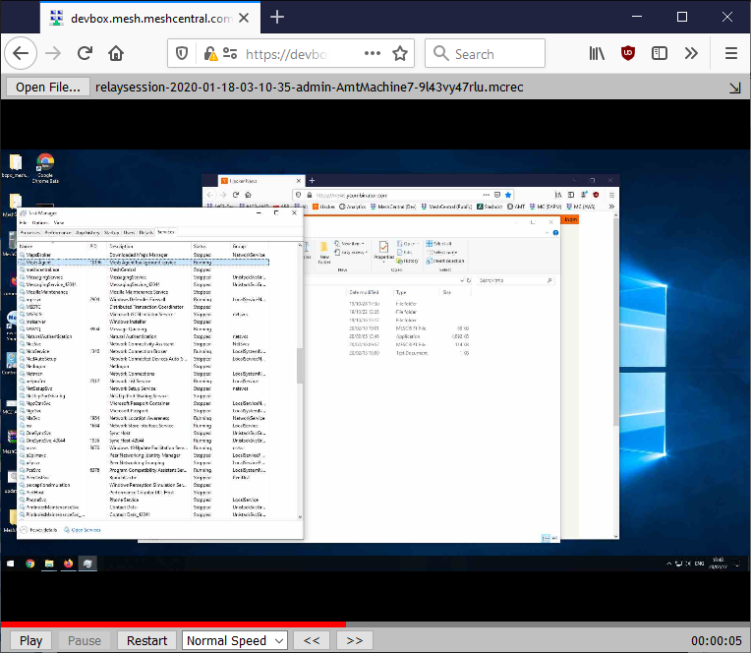
Recording.mcrec
Image1
Image2
Image3
Image4
…
Index

Slide 7
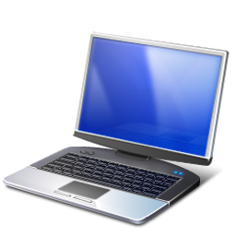
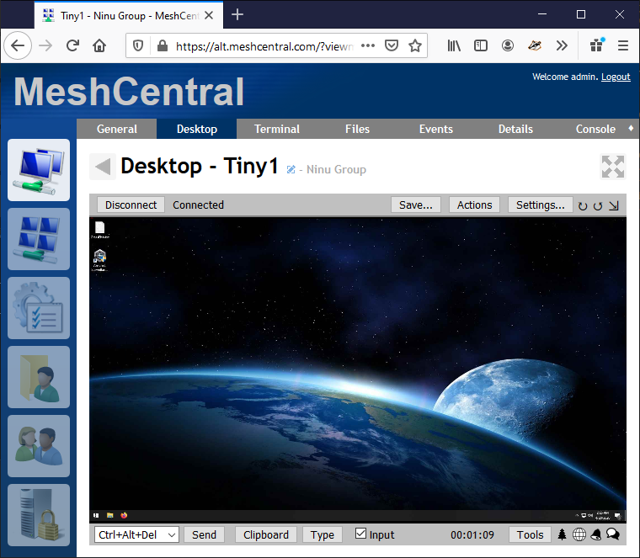
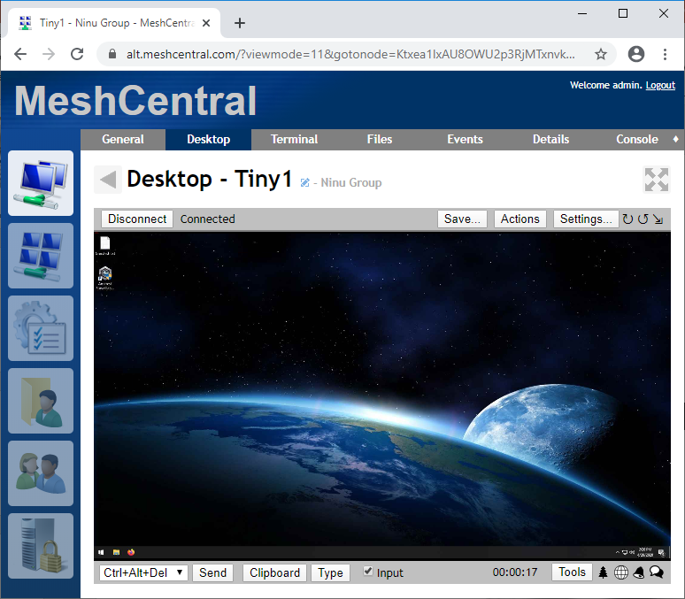
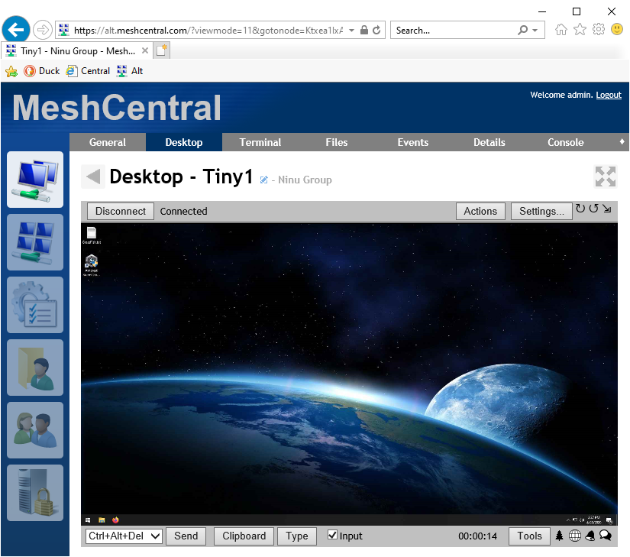

Slide 8
MeshCentral
“settings": {
"DesktopMultiplex": true,
}
Config.json

Slide 9
1
2
3
4
5
6
7
8
9
Frame numbers
1
1
1
1
1
Index
3
4
5
5
5
7
9

Slide 10

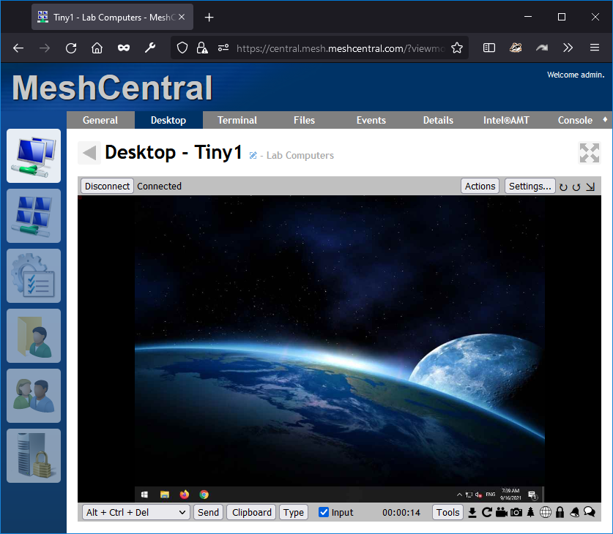
MeshCentral
Desktop
Multiplexor

Slide 11
100% User1 Traffic
MeshCentral
User1
MeshAgent
Desktop
Multiplexor
50% User1 and 50% User 2 Traffic
User2
100% User2 Traffic

